Slide 1


ITM 540
Data Networks
Layer 4: Transport Layer
TCP Call States
Professor: Carol Davids
Email: davids@iit.edu
Carol Davids © 2009

Slide 2
Managing Connections
We have said that connections are relationships between distant processes that endure over a period of time
The cost of creating connections is
  Memory blocks
  Processor cycles
Now we will see what some of the memory and processing is used for.
Carol Davids © 2009

Slide 3
Finite State Machine
We have seen the three way handshake for establishing a TCP connection - SYN, SYN/ACK, ACK
We have seen the way each side needs to disconnect using the FIN and ACK signals
Carol Davids © 2009

Slide 4
Finite State Machine
The receiving TCP processes SYNs, ACKs, FINs and other signaling messages differently depending on the history of the TCP connection
That is, depending on the State of the Connection
Carol Davids © 2009

Slide 5
Finite State Machine
A Finite State Machine is a model of the different states that the connection can be in
Examples of connection states:
  Closed
  Listen
  Established
  Last-Ack
Carol Davids © 2009

Slide 6
State Transition Diagram
The State Transition Diagram is a graphic way of representing:
The different states the connection can be in
The events that can cause the connection to transition from one state to another
The messages the TCP may need to send while it is making its transition from one state to another.
Carol Davids © 2009

Slide 7
TCP Connection States
In the state machine that defines the behavior of the TCP process, there are 11 different states of a connection.
If you perform the command netstat -a at the command line, you will see connections in some of these different states.
Carol Davids © 2009

Slide 8
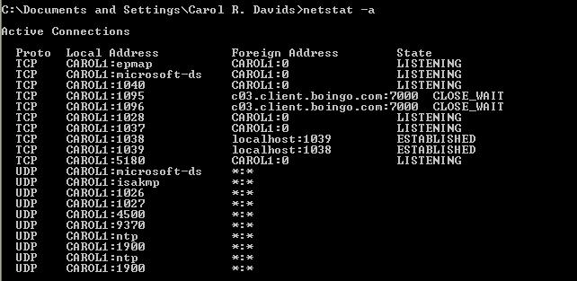
Netstat
Netstat can be used to show the state of the connections on a computing device.
Carol Davids © 2009

Slide 9
  CLOSED (the NULL state)
  LISTEN
  SYN-SENT
  SYN-RCVD
  ESTABLISHED
  CLOSE-WAIT
  FIN-WAIT-1
  CLOSING
  FIN-WAIT-2
  TIME-WAIT
  CLOSE-WAIT
  LAST-ACK
Carol Davids © 2009

Slide 10
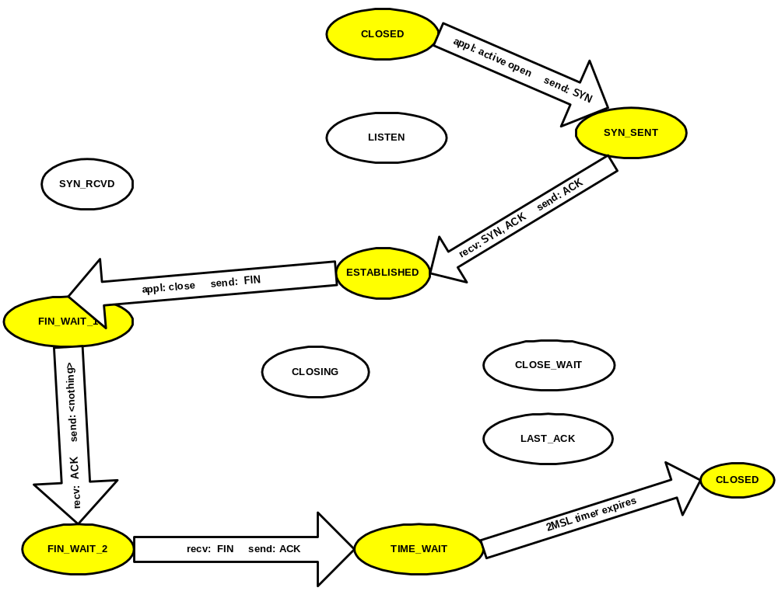
Client
Normal Connection States
Carol Davids © 2009

Slide 11
State Transition Diagram
The State Transition Diagram tells us:
  All the possible states the connection could be in
  The triggering events that can cause a transition from one state to the other
Carol Davids © 2009

Slide 12
Triggering Events
The triggering events can include:
  Receiving a message from the other side of the connection
  Receiving a message from the application
  Expiration of a timer
Carol Davids © 2009

Slide 13
Traversing a State Transition Diagram
The following pages show the normal state transitions for a TCP client
Carol Davids © 2009

Slide 14
CLOSED to SYN_SENT
The client’s “connection” object is in the closed state (fictitious).
The application indicates it wants to open a connection.
The TCP responds by sending a SYN and entering into the SYN-SENT state.
Carol Davids © 2009

Slide 15
SYN_SENT to ESTABLISHED
TCP then receives a SYN/ACK
It responds by sending an ACK and enters the ESTABLISHED state.
Carol Davids © 2009

Slide 16
ESTABLISHED to FIN_WAIT_1
The connection remains in the ESTABLISHED State for as long as the connection is needed.
Data is sent and received over the connection as long as the connection is in the ESTABLISHED state.
Then the application sends an indication that the connection should be closed.
TCP responds by sending a FIN and enters the FIN_WAIT_1 State.
Carol Davids © 2009

Slide 17
FIN_WAIT_1 to FIN_WAIT_2
In the FIN_WAIT_1 State TCP receives an ACK .
It sends nothing, and enters the FIN_WAIT_2 State and sets a timer to a value equal to two times the Maximum Segment Life (MSL).
Carol Davids © 2009

Slide 18
Client State Transitions
When this 2MSL timer expires, the connection returns to its “null state” the fictitious state we call CLOSED.
Carol Davids © 2009

Slide 19
TIME_WAIT State and the 2 MSL Timer
MSL means Maximum Segment Life
It is the maximum amount of time a segment may exist in the network.
  RFC 791 specifies MSL = 2 minutes
  Implementations provide various values for this parameter.
Carol Davids © 2009

Slide 20
TIME_WAIT State and the 2 MSL Timer
Possible values for MSL:
  30 seconds
  1 minute
  2 minutes
Carol Davids © 2009

Slide 21
Reason to use the 2 MSL Timer
Waiting a period of time equal to twice the MSL allows for the possibility that the last ACK was lost.
It allows TCP to resend the last ACK.
Carol Davids © 2009

Slide 22
Reason to use the 2 MSL Timer
The pair of sockets that defines the connection will not be available for re-use until the end of the 2MSL time period.
Carol Davids © 2009

Slide 23
Reason to use the 2 MSL Timer
When delayed segments arrive for a connection while the connection is in the TIME_WAIT state, the segments are discarded.
This means that if a new connection is established that uses the same socket, there is no way that old segments from the previous connection will be directed to the new connection.
Carol Davids © 2009

Slide 24
Active vs. Passive Open
The side that sends the first SYN is said to engage in an Active Open.
The side that receives this first SYN and responds with the SYN/ACK is said to engage in a Passive Open.
Carol Davids © 2009

Slide 25
Normal State Transitions for a Server
In the normal state transitions for a client that we just looked at, the client application performed an Active Open.
In the next slides we look at the normal state transitions for a Server and notice that here the server performs a Passive Open.
Carol Davids © 2009

Slide 26
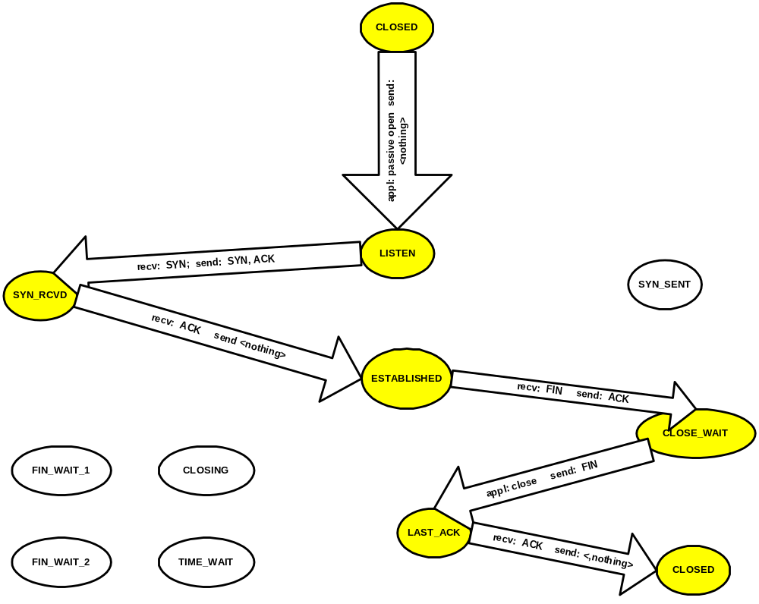
Server
Normal Connection States
Carol Davids © 2009

Slide 27
LISTEN State
The application does not trigger the first message, since it did not initiate this connection.
The server’s TCP is put into the LISTEN State by a “passive open” from the server application.
In LISTEN State the server is waiting for a connection request from any remote TCP and port.
Carol Davids © 2009

Slide 28
Detail on the LISTEN State
The Server Application identifies a socket.
The connection on the socket is created in the CLOSED State.
The Server sets the initial sequence number.
The Server initiates a Passive Open.
The connection enters the LISTEN State.
In the LISTEN State the server listens for TCP Connection requests from clients.
Carol Davids © 2009

Slide 29
LISTEN to SYN_RCVD
The TCP receives the SYN from the client and responds by sending a SYN/ACK and transitioning to the SYN_RCVD State.
Carol Davids © 2009

Slide 30
SYN_RCVD to ESTABLISHED
In the SYN_RCVD State the TCP receives an ACK.
It responds by sending nothing and transitioning into the ESTABLISHED State.
Carol Davids © 2009

Slide 31
ESTABLISHED to CLOSE_WAIT
In the ESTABLISHED State, data is being sent and received on behalf of the Application server.
The client is done using the connection and so sends a FIN.
The server TCP responds by sending an ACK and transitioning into the CLOSE_WAIT State
Carol Davids © 2009

Slide 32
CLOSE_WAIT to LAST_ACK
When the Application Server is done with the connection (has finished sending its data) is sends an indication of that to TCP.
TCP responds by sending a FIN and transitioning into the LAST_ACK State.
Carol Davids © 2009

Slide 33
LAST_ACK to CLOSED
In the LAST_ACK State, TCP receives an ACK.
It responds by sending nothing and transitioning into the CLOSED State.
Carol Davids © 2009

Slide 34
TCP Connections
A pair of sockets identifies a Connection.
The relationships between ports, sockets and connections is illustrated on the next pages.
Carol Davids © 2009

Slide 35
Memory for Connections
A pair of sockets identifies a Connection.
So of course TCP needs to remember the sockets being used for the connection
On the next pages we look at some other variables that must be stored as long as the connection endures
Carol Davids © 2009

Slide 36
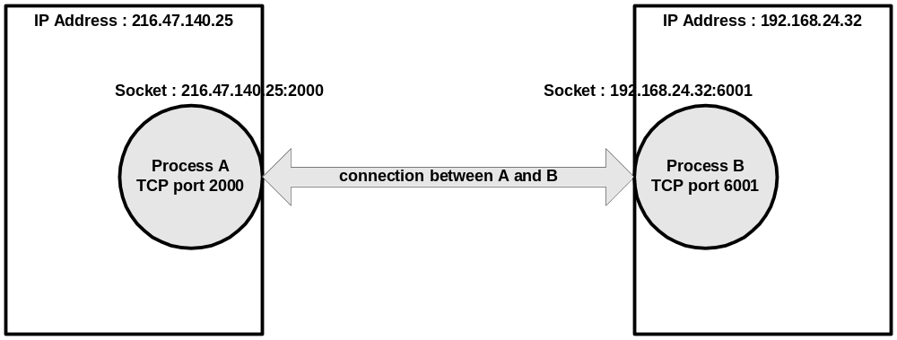
Process A uses TCP Port 2000.
Process A uses TCP Socket 216.47.140.25:2000.
The connection between Process A and Process B is identified by the pair of sockets 216.47.140.25:2000 , 192.168.24.32:6001
Carol Davids © 2009

Slide 37
Transmission Control Block
The maintenance of a TCP connection requires the remembering of several variables.
We conceive of these variables being stored in a connection record called a Transmission Control Block or TCB.
Carol Davids © 2009

Slide 38
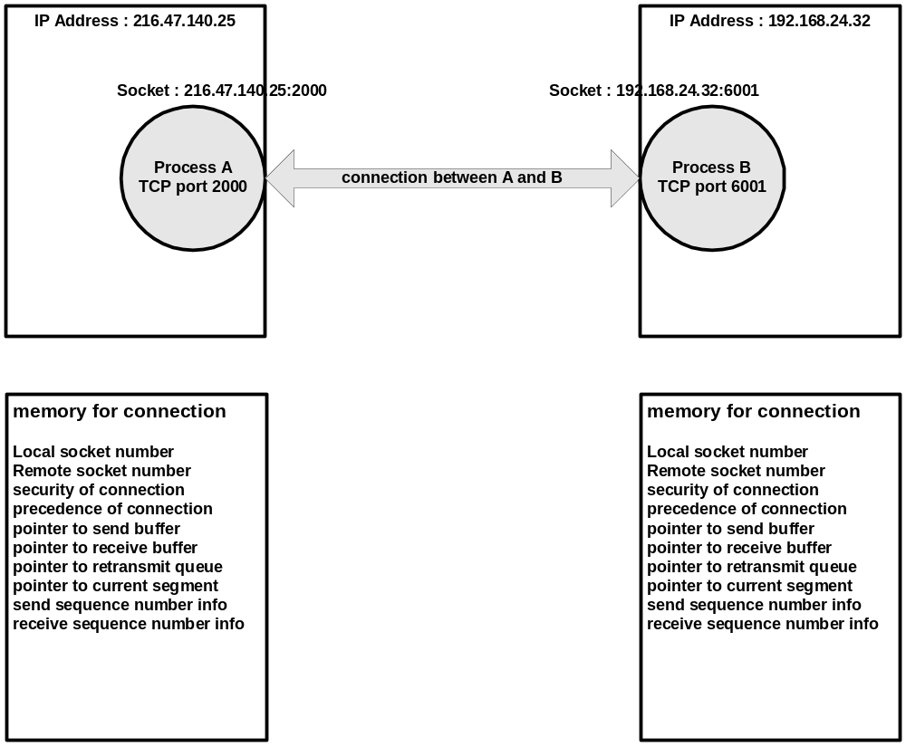
Transmission Control Block is a portion of memory in the device containing information about the connection.
Carol Davids © 2009

Slide 39
TCB variables
local socket number
remote socket number
security of the connection
precedence of the connection
pointer to the user's send buffer
pointer to the user’s receive buffer
pointer to the retransmit queue
pointer to the current segment.
variables relating to the send sequence number
variables relating to the receive sequence number
Carol Davids © 2009

Slide 40
The End
Carol Davids © 2009

Slide 41
TCP State Reference
http://www.tcpipguide.com/free/t_TCPOperationalOverviewandtheTCPFiniteStateMachineF-2.htm
The illustration on the next page, copied from this reference, provides a graphical representation of how the state transitions are made.
Accompanying this diagram in the reference is a brief description of each state.
Carol Davids © 2009

Slide 42
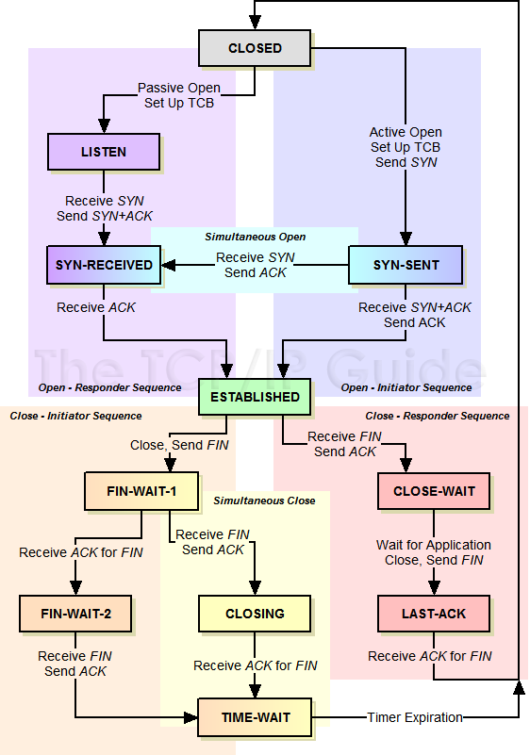
http://www.tcpipguide.com/free/t_TCPOperationalOverviewandtheTCPFiniteStateMachineF-2.htm
Carol Davids © 2009

Slide 43
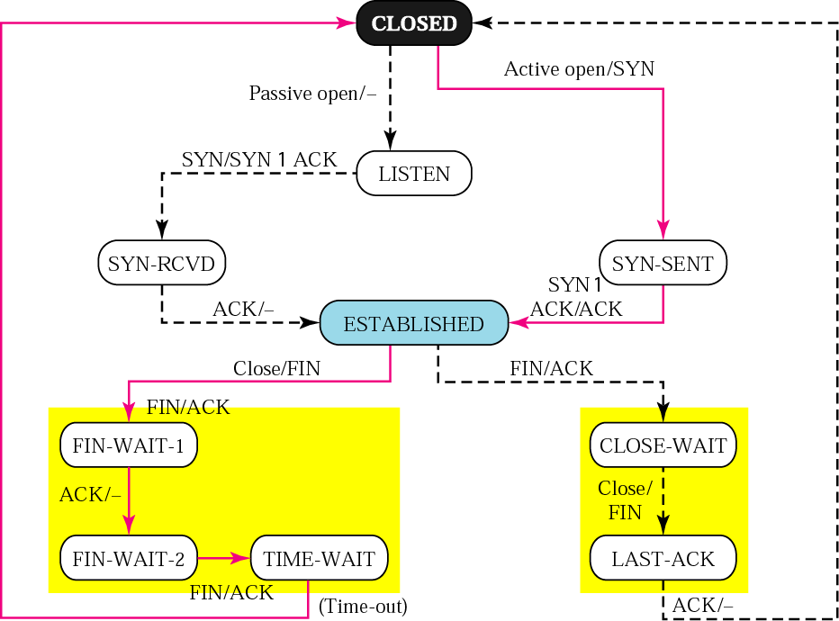
Forouzan: Figure 22.18:
Solid lines represent state transitions for client
Broken lines represent state transitions for server.
Carol Davids © 2009

Slide 44
The Client says…
“I detect the application’s need for my services which I call an Active open, and I issue a SYN and transition to the SYN-SENT state”
Carol Davids © 2009

Slide 45
The Client says…
“While in the SYN-SENT state I receive a SYN + ACK, I send an ACK and transition to the ESTABLISHED state”
Carol Davids © 2009

Slide 46
The Client says…
“While in the ESTABLISHED state, I detect the desire of the application to end the connection, so I issue a FIN and transition to the FIN-WAIT-1 state”
Carol Davids © 2009

Slide 47
OR, the Client says…
“While in the ESTABLISHED state, I receive a FIN from the server, so I issue a FIN/ACK and transition to the CLOSE-WAIT state.” (See pg 28 as well.)
Carol Davids © 2009

Slide 48
TCP Connections from the specification…
“When two processes wish to communicate, their TCP's must first establish a connection (initialize the status information on each side).
When their communication is complete, the connection is terminated or closed to free the resources for other uses.”
Carol Davids © 2009

Slide 49
TCP Multiplexing - Sockets
Remember that a TCP port is bound to a process in order that the process may receive data at that port.
The combination of the IP Address and this TCP port number is called a Socket.
(Remember that UDP also defined sockets this way.)
Carol Davids © 2009

